Slide 1
FAKE NEWS CLASSIFICATION PROJECT

Slide 2
Problem Statement
Fake news has become one of the biggest problems of our age. It has serious impact on our online as well as offline discourse. One can even go as far as saying that, to date, fake news poses a clear and present danger to western democracy and stability of the society. It is a NLP problem.

Slide 3
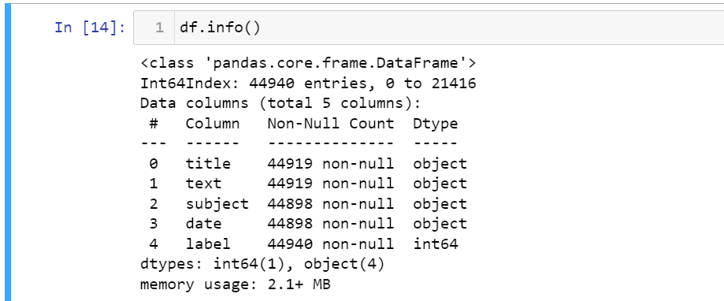
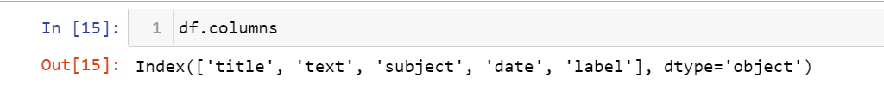
Exploratory Data Analysis
Shape of the data:
Following are the columns present and their respective data types:
There are two datasets are provided, one for fake news and other for true news so we just concatenate the
two datasets into one dataset with 44939 rows and 5 columns.

Slide 4
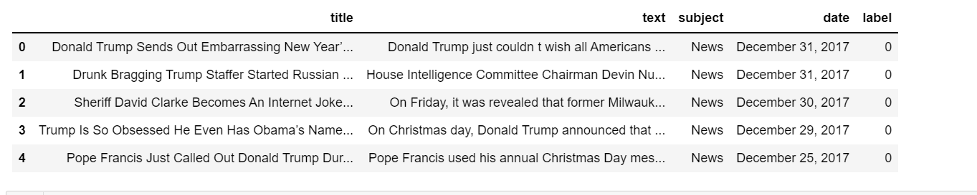
Here is the glimpse of data:

Slide 5
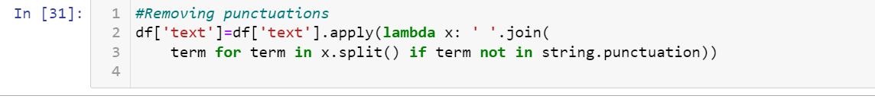
The dataset has null values so we dropped those rows with null values after checking the data loss percent.
Since this is a NLP problem so we have to analyse the text in text column and depending on that we have to predict
whether the news is real or fake, so we dropped other three columns i.e. date, subject and title.
Feature Engineering-We have to fetch important words from the text so in order to do that we first converted entire
text feature to lower case.
Further we removed all kinds of punctuations from the feature text.

Slide 6
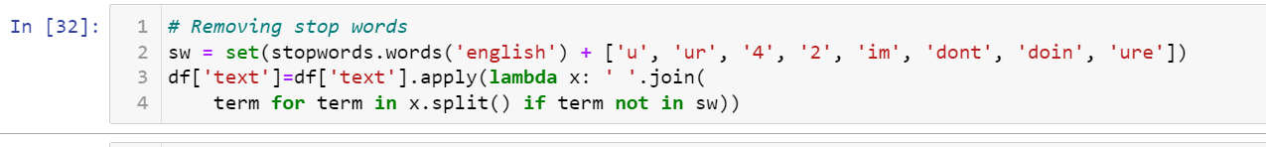
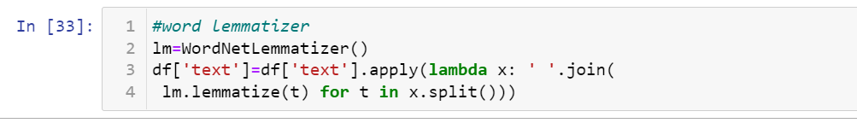
In order to focus on the words that could differentiate between fake and true news we also have to remove all
kind of stop words.
In order to further analyse the text using morphological analysis of the words called lemmatization.

Slide 7
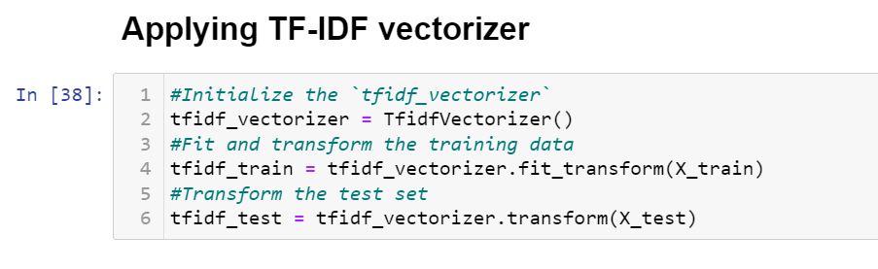
Then finally we converted the text into its vector form Term Frequency and Inverse Document Frequency method
We split the data into training set and testing set using train test split method.
On this train and test data we applied various models: logistic regression and naïve bayes classifier.
The best performing model is logistic regression with approximately 99% of accuracy.
So, we saved our logistic regression model.

Slide 8
Hardware and Software Requirements and Tools Used
We imported following packages:
import pandas as pd
import numpy as np
import matplotlib.pyplot as plt
import seaborn as sns
from sklearn.model_selection import train_test_split
from sklearn import metrics
from sklearn.metrics import roc_curve,auc,classification_report,confusion_matrix
from sklearn.feature_extraction.text import TfidfVectorizer
import warnings
warnings.filterwarnings('ignore')
from nltk.stem import WordNetLemmatizer
import nltk
from nltk.corpus import stopwords
import string
from sklearn.naive_bayes import MultinomialNB
from sklearn.metrics import accuracy_score
from sklearn.feature_extraction.text import CountVectorizer
from sklearn.linear_model import LogisticRegression

Slide 9
Run and Evaluate selected models

Slide 10
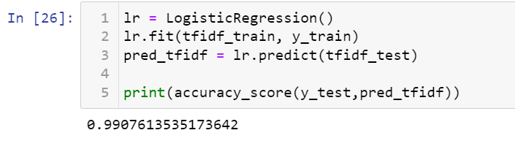
Logistic Regression
We applied logistic regressor classifier on the vectorized data and found that this model is predicting correct
labels 99% times.
We also checked the performance of this model on various other metrics such as confusion metrics, AUC-ROC curve
and classification report.

Slide 11
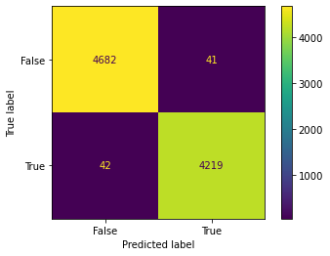
Confusion matrix:
Here we could observe that the model accuracy is quite good as the false positive and false negative predicted values are very less as compared to true positive and true negative.

Slide 12
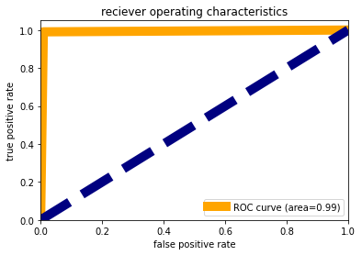
AUC-ROC Curve
Here we could observe that the area present under the curve is 0.99 which is quite a nice coverage and it means that 0.99 is the probability of giving correct prediction.

Slide 13
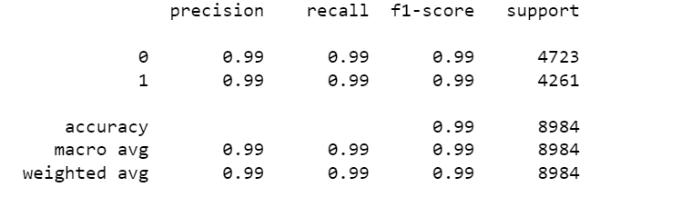
Classification Report
Here we could observe that the model is performing equally well in predicting label 0 than label 1 as its f1-score is same for both.

Slide 14
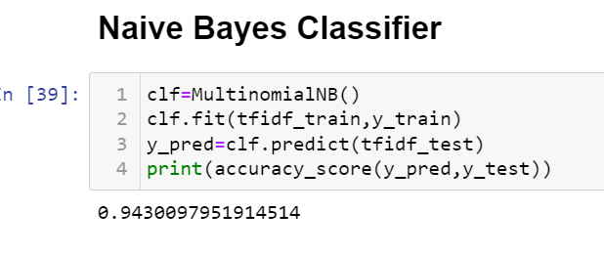
Naïve Bayes Classifier
We applied naïve bayes classifier on the vectorized data and found that this model is predicting correct
labels 94% times.
We also checked the performance of this model on various other metrics such as confusion metrics, AUC-ROC
curve and classification report.

Slide 15
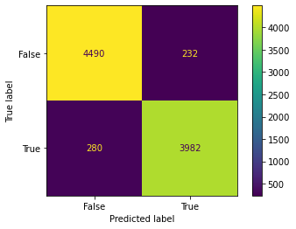
Confusion matrix:
Here we could observe that although the model accuracy is quite good but the false positive and false negative predicted values are quite high so in order to reduce this we applied logistic regressor.

Slide 16
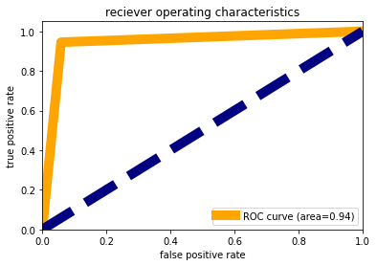
AUC-ROC Curve:
Here we could observe that the area present under the curve is 0.94 which is quite a nice coverage and it means that 0.94 is the probability of giving correct prediction.

Slide 17
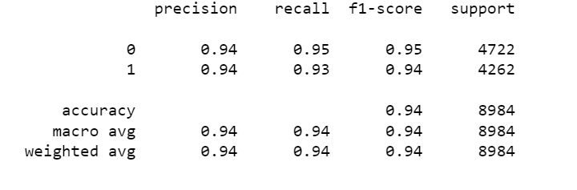
Classification Report:
Here we could observe that the model is performing better in predicting label 0 than label 1 as its f1-score is better than that of label 1.

Slide 18
Conclusion.
In today’s time, the majority of the tasks are done online. Newspapers that were earlier preferred as hard- copies are now being substituted by applications like Facebook, Twitter, and news articles to be read online. WhatsApp’s forwards are also a major source. The growing problem of fake news only makes things more complicated and tries to change or hamper the opinion and attitude of people towards use of digital technology. When a person is deceived by the real news two possible things happen- People start believing that their perceptions about a particular topic are true as assumed. Thus, in order to curb the phenomenon, we have developed our Fake news Prediction system that takes input from the user and classify it to be true or fake. To implement this, various NLP and Machine Learning Techniques have been used. The model is trained using an appropriate dataset and performance evaluation is also done using various performance measures. The best model, i.e. the model with highest accuracy is used to classify the news and our best performing model is Logistic regressor with accuracy 99%.

